Slide 1
Avoiding the middle income trap: Renovating Industrial Policy Formulation in Vietnam
Kenichi Ohno 2009

Slide 2
1. Entering a new era
Vietnamese economy has grown rapidly in 1991-2008, average growth rate 7.6%.
GDP per capita (2008) was $1,024, reached the status of lower middle income country.
However, achievements are driven by one time liberalization effect and external forces. Local firms uncompetitive, policies & institutions remain weak.

Slide 3
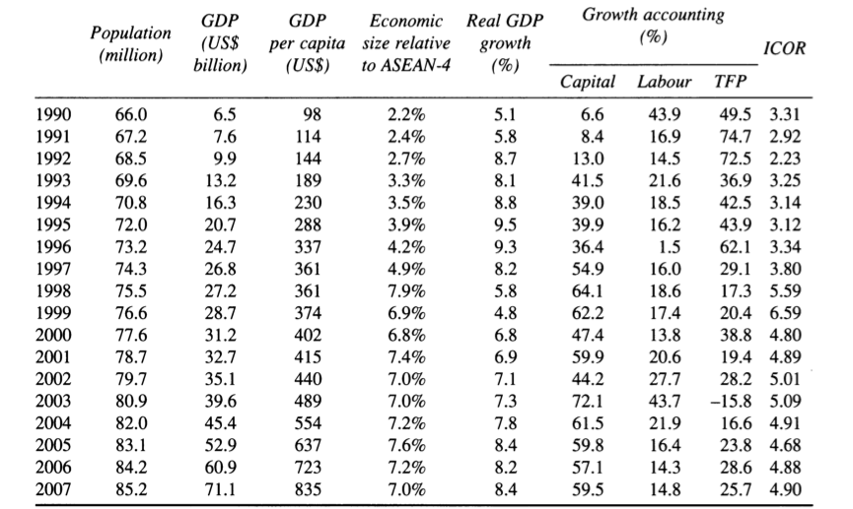
1. Entering a new era
Table 1: Vietnam: Summary of Growth Performance

Slide 4
1. Entering a new era
Higher the ratio, more capital is required for growth.
TFP: broad definition of productivity, calculated as residual growth after factor inputs (labor, capital) are accounted for.
Before mid 1990s, low ICOR, high TFP, growth was achieved through improved efficiency.
In the later period, ICOR rose, TFP declined, capital contribution increased.

Slide 5
2. The middle income trap
Pre Industrialization
Initial FDI absorprtion
Internalizing parts and components
Internalizing skills and technology
Internalizing innovation
Creativity
STAGE FOUR
Full capability in innovation and product design as global leader
Technology absorption
STAGE THREE
Management & technology mastered, can produce high quality goods
Agglomeration
Arrival of manufacturing FDI
STAGE TWO
Have supporting industries, still under foreign guidance
STAGE ONE
Simple manufacturing under foreign guidance
Japan, US, EU
STAGE ZERO
Monoculture, subsistence, agriculture, aid dependency
Korea, Taiwan
Thailand, Malaysia
Glass ceiling for ASEAN countries (Middle income trap)
Vietnam
Some African countries

Slide 6
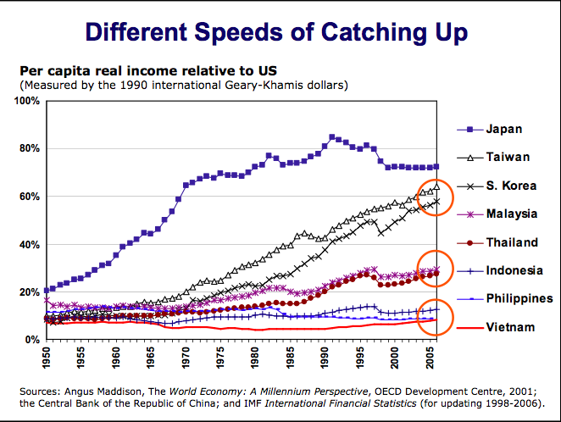
2. The middle income trap

Slide 7
2. The middle income trap
Developing countries must acquire skills and technologies, rather than just offering space and cheap labor in order to overcome middle income trap.
a. labor productivity should grow faster than wage increase in order to remain competitive.
b. “manufacturing plus plus”: 1)expand along the value chain to encompass higher value added activities 2)uplift the whole value chain by raising productivity.

Slide 8
2. The middle income trap
c. Japanese concept of “monozukuri”: to achieve customer satisfaction rather than just make profits.
d. theory of business architecture: developing countries should form strategic alliance with Japanese manufacturing firms.

Slide 9
3. Policy vision and orientation
In high performing economies in East Asia, industrial policy usually takes a goal-targeting form. (working backward from broad goals to phased strategies)
Vietnam: long term vision of achieving industrialization and modernization by 2020.
But it lacks proper strategies and plans.
Vietnam should formulate as soon as possible a clear roadmap to inform and guide its people, investors and policy makers.

Slide 10
4. Policy making procedure and organization
Problems (unique) with Vietnam’s policy making:
Procedural problem
a)Lack of involvement of business community
b)Lack of inter-ministerial coordination
→Approved policies ineffective or unimplemented
Organizational problem
a)No clear directives from top leader
b)Quality decline of government officials

Slide 11
4. Policy making procedure and organization
Solutions to procedural problem
Have a strong top leader who directs various ministers
Let a super ministry lead industrial policy making and be responsible for it
Establish powerful technocrat team directly serving the president (prime minister)
Install mechanism to guarantee the involvement of shareholders when making policy

Slide 12
4. Policy making procedure and organization
Solutions to procedural problem
Down sizing of public sector (through forced retirement, outsourcing non essential services, etc.)
Establish competitive and transparent recruiting system
Performance based salary schedule

Slide 13
5. How to break a solidified system
To change policy formation
1). Collective mutation:
spontaneous and internally driven
a generation with new values and behavioral patterns grow up
2). Foreigners
Bring or even force new elements
3). Policy
Drastic policy shifts are usually introduced when a new strong top leader comes to power

Slide 14
5. How to break a solidified system
Three players that make institutional reform possible
1). Leadership
Especially in developing countries, where political systems are less well developed, initiatives for bold changes must come from top leader.
2). The technocrat team
Technocrat team directly responsible for top leader. Act as nation’s brain for development.
3). Foreign partnership
Bilateral and multilateral donors desire to see faster reforms and more transparency.
But their focus should shift from the removal of negatives to the creation of Vietnam’s unique strength.

Slide 15
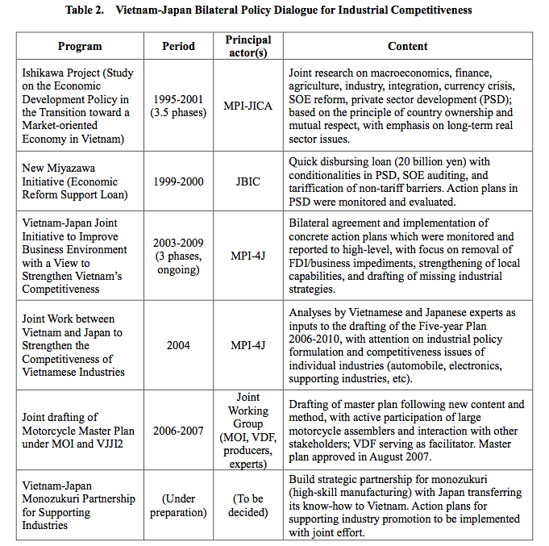

Slide 16
6. Conclusion
Vietnam has reached the status of lower middle income country.
Past success mainly comes from a one time liberalization, which is unsustainable.
Acquiring skills and technology, updating human capital, and enhancing internal value creation ability help overcome middle income trap.
Significant changes (reform) are needed for Vietnam to change its policy formulation process in order to improve policy quality.
Enlightened and strong leadership, a new technocrat and strategic partnerships with foreigner should help.

